Slide 1
Thesis Showcase
By: William Poole

Slide 2
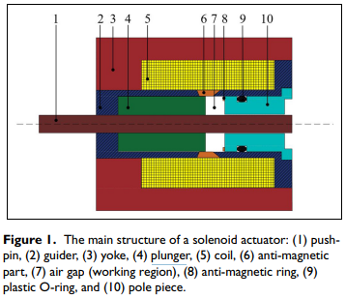
Solenoid Actuator Design
Push-Pin: A shaft for force transfer
Guider: Sliding axis for system
Yoke: Housing of system
Plunger: Magnetic field transducer
Coil: Magnetic field generation source
Anti-Magnetic part: Field Pass through adjustment
Air gap: Room for travel
Anti-Magnetic Ring: Purpose Unknown {spacer component as pole piece is also magnetic
O-ring: Debris blocking seal
Pole-piece: Artificial magnet to pull plunger {Tied to solenoid}

Slide 3








Force Formulation
There are multiple formulations of the force on the plunger [Fm]
Shape Optimization Doc
Design Optimization Doc

Slide 4
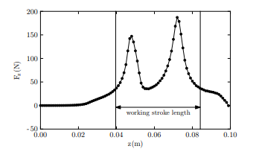
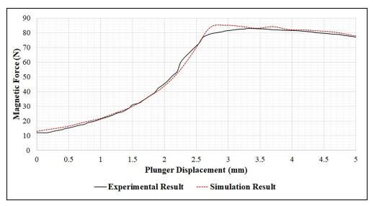
Force Curves
Solenoids have issues with force curves, as across their working distance their force is inconsistent. The change can be up to a factor greater than 3 times than at other points in the range.
Shape-Optimization
Design Optimization Actuator

Slide 5
Force Curve Linearization
To flatten a curve there are multiple methods:
Current or Voltage of the coil
Advance design of coil or plunger
Current or Voltage Control
Coil or Plunger Design Optimization
Pro
Con
Pro
Con
Controls Unnecessary
Cheaper manufacture likely
Simple components
Complex Theory
Will suffer from variation of components
Simple theory
More information on projectile system
Launch material adjustment
Difficult to perform, know kinematic features that are interdependent position, velocity, and acceleration
High speed current control

Slide 6
Shape-Optimization mentions:
“Control of the field current is, in this case, not easy. It must take into account the instantaneous velocity of movement of the plunger and non-linearity of the system, which requires sophisticated sensors, microcomputer and an appropriate electronic circuitry. A more advantageous way is, therefore, shape adjustment of the ferromagnetic parts of the device, which does not provide a quite perfectly linear characteristic, but its shape may be considered still acceptable. In this case, no further current control is needed.”

Slide 7
Optimization parameters
There are many features to optimize:
Maximal force: |Fm|
Stroke distance: |d|
Force peak-to-peak: ∆Fm
Power draw: |P|
Weight: |W|
Size: V

Slide 8
Force Magnitude
The location of peak is dependent on shape. So shaping of the coils is only for manipulating force curve.
However, the # turns, turn density, materials projectile or wire, projectile shape, and gaps manipulates peaks

Slide 9
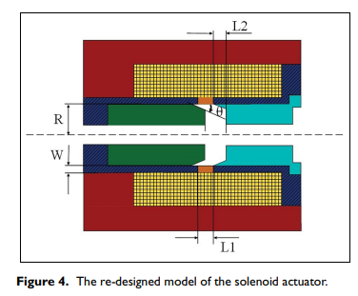
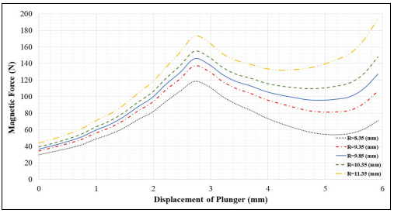
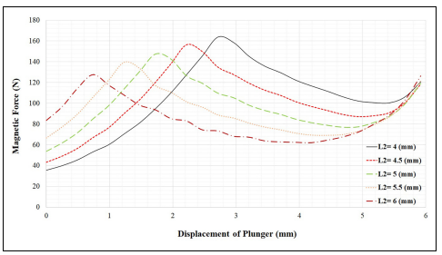
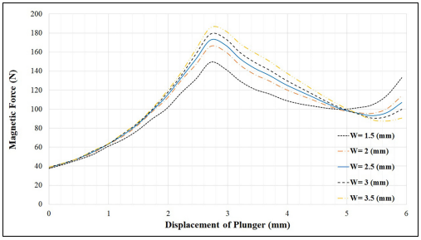
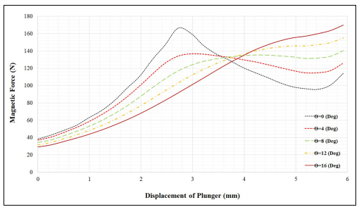
Manipulations for magnitude

Slide 10
Results
Manipulation of R shows only positive relationship to force magnitude, however increasing plunger mass will slow down system.
Manipulation of W shows only positive relationship to force magnitude; however it seems to decay with expansion. Field to plunger interaction is based on geometry.
L1 showed no relations to force
Manipulations of Θ can show movement or reduction of the peak, keep it for flattening curve or geometry optimization
L2 shows heightening of force peak and shifting

Slide 11
Stroke distance
Controlled by air gap needs to have field curl across large length
Use multiple delayed solenoids to increase force over travel
Projectile manipulations as well

Slide 12
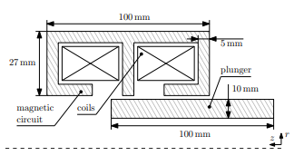
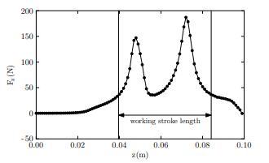
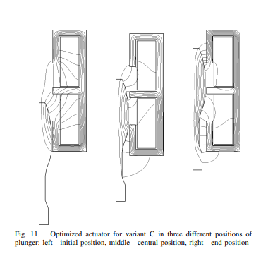
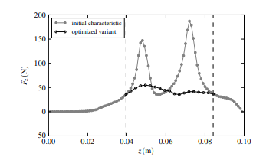
Peak-to-Peak Optimization
Best way to flatten curve is by imposing two fields
to smooth out force across projectile

Slide 13
Power Draw
System is current dependent, so methods are limiting:
P=v*I (Drop voltage)
Lower series resistance
Decrease duty cycle while maintain draw
Optimize force necessary:
Friction reduction
High magnetic moment materials

Slide 14
Weight and Size
Weight is correlated to size:
Decrease turns:
Higher power
high voltage and current may be sufficient to decrease turns
Decrease Yoke size
Material selection for weight

